Slide 1
Databases

Slide 2
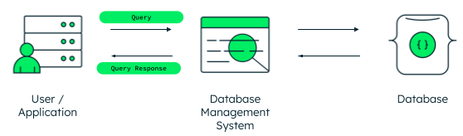
database
A database is information that is set up for easy access, management and updating. Computer databases typically store aggregations of data records or files that contain information, such as sales transactions, customer data, financials and product information.

Slide 3
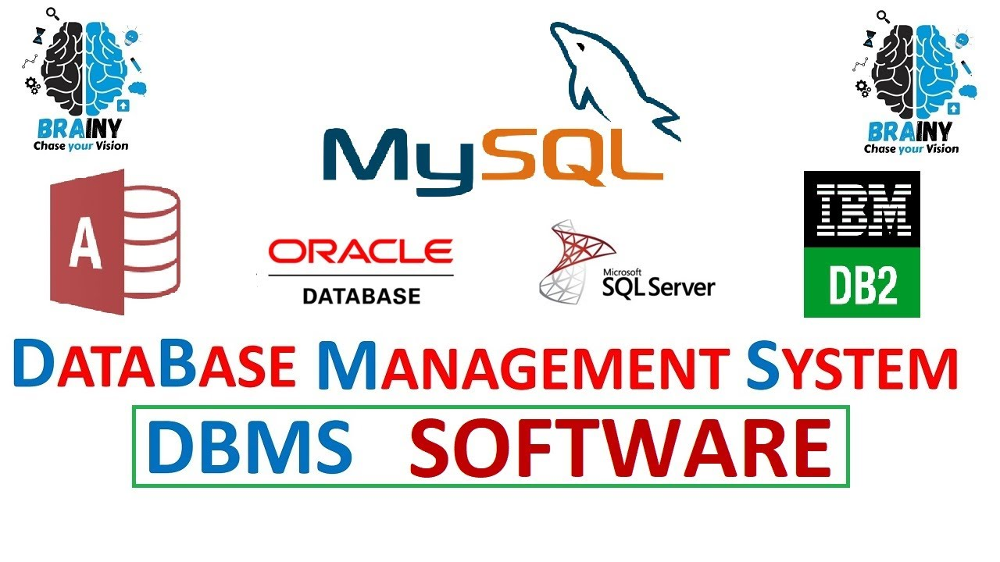
database management system sgdb
A database management system (or DBMS) is essentially nothing more than a computerized data-keeping system. Users of the system are given facilities to perform several kinds of operations on such a system for either manipulation of the data in the database or the management of the database structure itself.

Slide 4
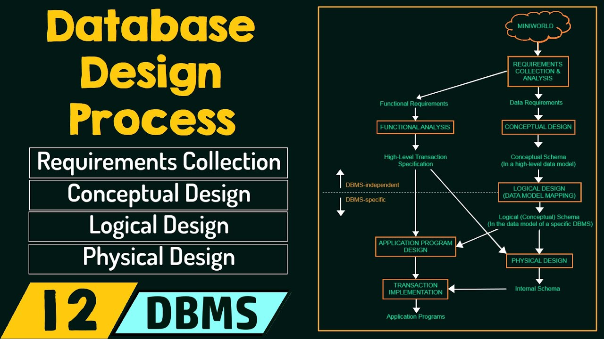
database proccesses
Data processing modes or computing modes are classifications of different types of computer processing.
Interactive computing or Interactive processing, historically introduced as Time-sharing.
Transaction processing.
Batch processing.
Real-time processing.

Slide 5
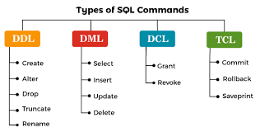
Type of database commands
Data Definition Language (DDL) is a subset of SQL. It is a language for describing data and its relationships in a database. You can generate DDL in a script for database objects to: Keep a snapshot of the database structure.
Dml A data manipulation language (DML) is a family of computer languages including commands permitting users to manipulate data in a database
TCL stands for Transaction Control Languages. These commands are used for maintaining consistency of the database and for the management of transactions made by the DML commands. A Transaction is a set of SQL statements that are executed on the data stored in DBMS

Slide 6
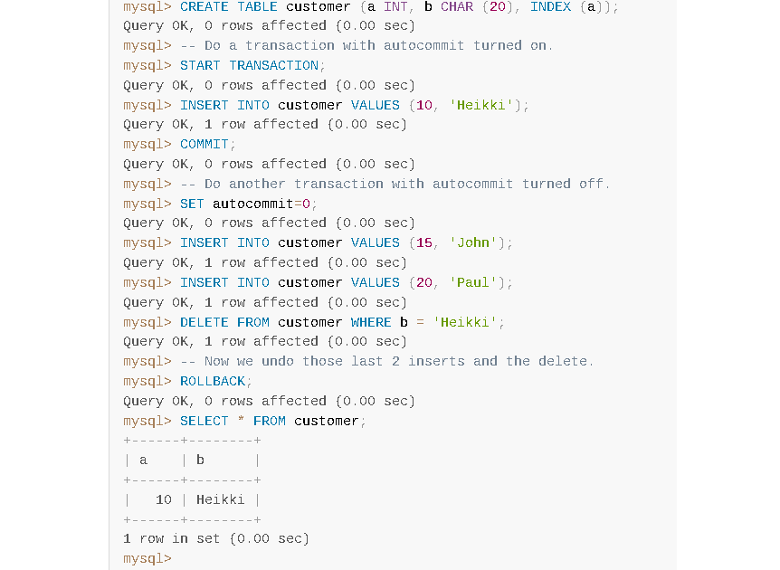
example

